Slide 1
2014-2015
At Risk After School Supper Program Training
for
After School Program Staff
Provided by the LAUSD Food Services Division
07.16.2014
Notes:
TELL:
Welcome to the At Risk Afterschool Supper Program training. Thank you for being here today.
My name is (state your name)
Currently 14 states have the Afterschool Supper Program and August 14th , 2013 we joined those existing states when Beyond the Bell and LA’s Best At Risk Afterschool Programs began serving supper rather than a snack.

Slide 2
Overview
What is After School Supper?
Required documentation
Role of the Food Service Staff staff
Monitoring requirements
Responsibilities of the Afterschool Program staff
Notes:
READ SLIDE:
During this training we will focus on;
What is the At Risk After School Supper program. We will explore in detail the required documentation needed to remain in compliance with the USDA and the CDE rules and regulations.
Have a clear understanding of the vital role and the responsibilities of both the Food Services and Afterschool Program staff.
As well as, become familiar with the program monitoring reports and requirements.

Slide 3
Purpose and Benefits
Long time spans between meals
  By the time children arrive at their afterschool program, lunch is a distant memory
  Children require more than a snack to sustain them throughout the afternoon and early evening
Show increased focus
  Providing healthy food after school allows children to be fully engaged in activities
Notes:
Tell:
According to the 2010 Healthy Hunger Free Kids Act; the following are benefits of the After School Supper program:
There is a long span between meals. Students had lunch at around 11 am and by the time the children arrive at their afterschool program, lunch is a distant memory. Their next meal is a snack served at 4pm consisting of a beverage and a bread item. That snack must sustain the children until they go home for dinner.
Providing healthy food after school allows children to be fully engaged in activities, giving them energy to move around and participate in physical activities.

Slide 4
Purpose and Benefits cont’d
Keeps children from going hungry
  Food children receive at an afternoon program may be the only meal until the next day
  Many families are struggling financially and programs that provide a nutritious meal after school make it easier to make ends meet and keep children from going hungry
Notes:
Tell:
Also, unfortunately the only meals some of our students consume are the ones they receive at school. In many households the only meal they will receive after their supper will be breakfast at school the next day.
Simply put, the supper program keeps children from going hungry.

Slide 5
Goal
Our goal is to provide the meal immediately after school to ensure the maximum number of children will have access to the suppers
This program is designed to fill the nutritional gap and ensure children receive the meals they need
The After School Supper program is a mandate for all eligible Beyond the Bell program sites
Notes:
Tell:
Our goal is to provide the meal immediately after school to ensure the maximum number of children will have access to the suppers.
This program is designed to fill the nutritional gap and ensure children receive the meals they need.
The After School Supper program is a mandate for all eligible Beyond the Bell program sites.

Slide 6
What Is After School Supper?
Child & Adult Care Food Program (CACFP) provides reimbursements for supper served to school aged children
  Up to the age of 18 (or individuals of any age if disabled)
  Do not have to be enrolled in the after school program
  No requirement that children receiving meals participate in the offered activities
  Available afterschool, on weekends, and holidays
Food Services Division (FS Division) sponsors the after school supper program
FS Division enters into an agreement with the California Department of Education (CDE) and assumes full responsibility for meeting all requirements for reimbursements
Notes:
Tell:
The Child & Adult Care Food Program (CACFP) provides reimbursements for suppers served to school aged children up to the age of 18 (or individuals of any age if disabled). They do not have to be enrolled in the after school program. There are no requirement that children receiving meals, participate in the offered activities and the program may be available after school, on weekends and holidays if applicable.
The Food Services Division (FS Division) sponsors the after school supper program and we have entered into an agreement with the California Department of Education (CDE) and assumes full responsibility for meeting all requirements for reimbursements.

Slide 7
Program Requirements
Area Eligibility Guidelines
  “Area Eligible” Sites
    50 % or more of students qualify for free or reduced meals
    Use the After School Supper Form
      Accurate counts important – reimbursement for our program depends on these meal counts
Notes:
TELL:
Area Eligibility Guidelines
“Area Eligible” Sites
50 % or more of students qualify for free or reduced meals
Use the After School Supper Form
Accurate counts important – reimbursement for our program depends on these meal counts

Slide 8
Required Documentation
  Prepare copies of the following documents and keep on hand at all times:
  Supper Service Agreement – Signed yearly by the Food Services Manager and After School Program Staff
  Training Roster – Signed yearly by the FS Manager and After School Program Staff
  Supper Meal Count Form – Returned daily to the FS Manager
  At Risk After School Program Reimbursable Meal Worksheet – Returned daily to the FS Manager
  Supper Community Feed Attendance Roster – Returned daily to the FS Manager
    Youth Services and Community Members
  Attendance Rosters – Returned weekly to the FS Manager
Notes:
TELL:
The Supper Service Agreement must be returned to the FSM on the first day of meal service. Be sure to retain a copy for your records, make sure you have this on file.
The training roster is provided by your program coordinators and copies will be provided to Food Services for your records. This annual training is a requirement from the CDE who monitors our Supper program.
Supper Count Forms are turned in daily ,you will see this later in the presentation
“At Risk After School Program Reimbursable Meal Worksheet” and “Supper Community Feed Attendance Roster” are also needed to turn in to the FS Manager daily and you will see these worksheet/Roster later in the presentation as well.
Attendance Rosters must be returned to the FS Manager weekly from the Beyond the Bell agencies at elementary and middle school sites.

Slide 9
Food Services Staff Role:
Ordering and Meal Preparation
Order Suppers
  Adjustments to orders will be made based on
    Production history
    Feedback from onsite supper program staff
Prepare Suppers
  Determine the amount of servings for all programs
  1% or non-fat milk and a minimum of two (2) lactose free milks is to be provided
    Inside Styrofoam ice chests with ice or ice pillow packs (where available)
    Inside refrigerated beverage cooler
    Food Service staff are required to provide two (2) clean thermometers
  Program coordinator is required to take and record temperatures of all refrigerated food items
Notes:
Read the slide –

Slide 10
Food Services Staff Role:
Poster & Record Keeping Requirement
Provide “And Justice for All” poster
  Tape it on the Styrofoam box or provide to the supper staff for posting
Provide the supper meal count form to the afterschool program staff
  Supper program staff must complete forms, signing daily
  A Production Record must reflect the total amount of all supper meals prepared
  Notify AFSS (supervisor) when required paperwork has not been submitted
  File all paperwork for 3 years plus current school year
  Review/Verify the supper count forms daily
  Submit daily claim of reimbursable suppers served within the CMS System
Notes:
READ SLIDE:

Slide 11
Food Services Staff Role:
Monitoring Timeline
  The first monitoring 4 weeks after the start of program
    Completed before September 10, 2014
    No more than six months may lapse between reviews
      The second monitoring must be conducted prior to winter break
      Completed before December 19, 2014
    The third monitoring must be conducted prior to spring break
      Completed before March 27, 2015
Notes:
READ SLIDE:

Slide 12
Students With Food Allergies
After School Program Staff will communicate with the FS Manager of any students with severe food allergies
FS Managers are to provide the “Medical Statement to Request Special Diets” to families for completion by the child’s treating physician
The FS Manager will make substitutions prescribed by the student’s physician when the physician’s statement indicates that food allergies may result in severe life-threatening (anaphylactic) reactions or in some cases non-severe allergic reactions.
The FS Manager provides special diets for students with documented conditions requiring dietary modifications.
Notes:
TELL:
After School Program Staff should have on hand blank copies of the “Medical Statement to Request Special Diets” in the event a child inform them of any severe food allergies. Program Staff will communicate with the FS Manager of any students with severe food allergies. FS Managers are to provide the “Medical Statement to Request Special Diets” to families for completion by the child’s treating physician.
The FS Manager will make substitutions prescribed by the student’s physician when the physician’s statement indicates that food allergies may result in severe life-threatening (anaphylactic) reactions or in some cases non-severe allergic reactions.
The FS Manager provides special diets for students with documented conditions requiring dietary modifications.

Slide 13
Students At Special Education Centers
If you are hosting an After School Supper Program at a Special Education Center, there is a Special Education Center supper menu available
The After School Program Coordinator will communicate with the FS
Manager to ensure the appropriate menu is provided for the participating children's needs
The FS Manager will provide meals for students requiring dietary modifications
Children are not required to take a supper meal
The FS Manager will make substitutions prescribed by the student’s physician when the physician’s statement indicates that food allergies may result in severe life-threatening (anaphylactic) reactions or in some cases non-severe allergic reactions.
Notes:
TELL:
If you are hosting an After School Supper Program at a Special Education Center, there is a Special Education Center supper menu available and must be followed.
The After School Program Coordinator will communicate with the FS Manager to ensure the appropriate menu is provided for the participating children's needs.
The FS Manager will provide meals for students requiring dietary modifications such as blended meals and tube feeding.
Children are not required to take a supper meal.
The FS Manager will make substitutions prescribed by the student’s physician when the physician’s statement indicates that food allergies may result in severe life threatening (anaphylactic) reactions or in some cases non-severe allergic reactions.
The FS Manager provides special diets for students with documented conditions requiring dietary modifications.

Slide 14
Notes:
TELL: This is an example of the Supper Count form. This document is completed and provided with the meals. The heading and columns 1 through 3 are completed by the Food Services Manager. The remaining columns, along with the daily attendance is completed by the Site Coordinator or designee.

Slide 15
  Supper Meal Count Form Instructions
  Number in Attendance Today: Program Coordinator or designee must enter the number of children in attendance
  Program Name: Food Service Manager (FSM) or designee must fill in the program name (BYB, YS, etc)
  Loc Code: Food Service Manager or designee must fill in the site location code
  Date: Food Service Manager or designee must fill in the date of meal service
  Preparation School Site Name: Food Service Manager or designee must fill in the name of the school site
  Loc Code: Food Service Manager or designee must fill in the site location code
  Column 1 – FSM will enter menu items
  Column 2 – FSM will enter the portion sizes
  Column 3 - FSM or designee fills in the amount of meals prepared
  Column 4 - Program Coordinator or designee must enter the amount received from the cafeteria
  Column 5 – Program Coordinator or designee must record the temperatures for all perishables items, e.g. juice, milk, cheese, Program Coordinator or designee records their initials and indicates the time the temperature is taken. (Clean/sanitized thermometers are provided by the FSM)
  Column 6 - Program Coordinator or designee must fill in the time service begins prior to meal service
  Column 7 - Program Coordinator or designee enters the number of adult meals served
  Column 8 - Program Coordinator or designee must enter the count of the number of children served a meal. Information is taken from the Reimbursable Meal Worksheet.
  Column 9 - Program Coordinator or designee must list the amount of un-served leftovers for each food item
Notes:
TELL: The Supper Meal Count Form is completed by both the FSM and the Program Coordinator or designee. Let’s review the instruction.
READ SLIDE:

Slide 16
Supper Meal Count Form Instructions, cont’d
Column 10 – Program Coordinator or designee must enter the number of children served a meal. Information is taken from column #8
Column 11 - Program Coordinator or designee must enter of the number of children served a meal. Information is taken from column #8.
Column 12 - Program Coordinator or designee must enter the total cash collected for adult meals paid in column # 7. Adults are required to pay the a la carte prices for all menu items.
Signature: Program Coordinator or designee must sign in the designated signature area and return the completed Supper Count Form to the cafeteria the following day along with any leftover food items.
Signature: Food Services Manager will verify the accuracy of the information completed by the Program Coordinator or designee and must sign in the designated signature area
Comments Section: Program Coordinator or designee will document any dropped, damaged and or incomplete meals. Additional comments may be communicated to the Food Services Manager in this section.
* Meal Count Adjustments: Program Coordinator or designee must indicate if the meal counts need to be adjusted for the next day’s meal service.
**Lactose Free Milk Count Adjustments: Program Coordinator or designee must indicate if the lactose free milk counts need to be adjusted for the next day’s meal service. Food Service Managers must have a minimum of two (2) cartons of lactose free milk available each days service.
Notes:
INSTRUCTOR: Continue to read the instructions from the slide.
TELL: The comment section, meal count adjustments and lactose free milk count adjustments are new on the form. This information was added to enhance the communication between the Program Coordinator or designee with the FSM.
READ SLIDE:

Slide 17
After School Supper Program Staff Role:
    Attend training
    Read & Sign “Supper Service Agreement”
    Post “And Justice For All” sign (provided by FS Manager)
      Visible to participants during supper service
      Follow all point of service procedures at the designated serving time
      Return all forms completed and on time
      Supper Meal Count Forms
      Supper Community Feed Attendance Rosters
      At Risk After School Supper Program Reimbursable Meal Worksheet
      Attendance Rosters
      Facilitate communication with the Food Services Manager
Notes:
READ SLIDE:

Slide 18
After School Supper Program Staff Role: Meal Ordering
  Submit an estimated count to the Food Services Manager that reflects a reasonable expectation of the number of supper units needed
  Counts should be adjusted (up and down) as warranted to ensure enough meals are available and there are no extras/leftovers
  Food Services Manager must have 2 weeks notice to make adjustments to supper orders
  Notify Food Services Manager of any upcoming events that may effect the supper counts
Notes:
READ SLIDE:
This was stressed to the program staff of the importance of communication between FSM and onsite staff

Slide 19
After School Supper Program Staff Role: Meal Service Time
  Primary serving time will be immediately after-school dismissal in order to maximize the access to the supper meal to all interested participants whether or not they are part of the daily afterschool program.
    Elementary – 2:30 pm
    Secondary – 3:00 pm
    School sites with more than one supper program must make every effort to serve suppers at the same time in the same designated eating area, this will help avoid children receiving more than one supper
  Programs must be able to verify only one meal per child was received
Notes:
READ SLIDE

Slide 20
After School Supper Program Staff Role: Meal Service
Supervision of the supper program should be a priority for ALL After School Program staff during the peak service time
Beyond the Bell/Youth Services staff will be responsible for coordinating the meal service for:
  Their programs
  Other students whose sole purpose for being on campus after school is to take part in the supper program (“general participants”)
Other organized programs may participate as separate entities or as part of the general participants
Notes:
TELL:
The Supervision of the supper program should be a priority for ALL After School program staff during the peak service time
Beyond the Bell/Youth Services staff will be responsible for coordinating the meal service for:
Their programs
Other students whose sole purpose for being on campus after school is to take part in the supper program (“general participants”)
Other organized programs may participate as separate entities or as part of the general participants

Slide 21
After School Supper Program Staff Role: Meal Service cont’d
    A daily Supper Meal Count Form will be completed by each program indicating the number of meals received, number of meals served, and amount left.
    Each participant may take only one complete supper meal per
    day, which will include multiple items
        A complete supper meal must be taken: supper kit and milk
        Partial meals may not be taken
    The number of supper meals served may never be more than the number of students indicated on the sheets as having been served a supper meal for the day.
    Food may not leave the school premises
        Suppers are consumed on campus
    Children are not required to take a supper meal
Notes:
TELL:
A daily Supper Meal Count Form will be completed by each program indicating the number of meals received, number of meals served, and amount left.
Each participant may take only one complete supper meal per day, which will include multiple items. An example of a complete meal includes a supper kit and 1% or non fat milk. Partial meals may not be taken, so a child may not take only the juice and sunflower seeds. This would be considered an non-reimbursable meal and could not be counted as served.
The number of supper meals served may never be more than the number of students indicated on the Reimbursable Meal Worksheet and the attendance rosters.
Once again, we remind you that food may not leave the school premises. Suppers are consumed on the campus.
Children are not required to take a supper meal, however we want to encourage the children to participate in the supper meal program.

Slide 22
After School Supper Program Staff Role: Food Safety Requirement
Take temperature of non-shelf stable food items (i.e. milk)
    Food Service Manager will provide two (2) cleaned and sanitized bi-metallic thermometers daily with the meals
      Milk temperatures are taken by placing the bi-metallic stemmed thermometer between two milks cartons
      Temperature of food items is taken by inserting the bi-metallic stemmed thermometer into the food item
        Food items that have had the temperatures taken may be served to students, they are not damaged
      Document the temperatures on the Supper Count Form
      Record actual temperature
Notes:
TELL:
We are required by state law to take and record the temperatures of non-shelf stable food items. For example milk and chicken sandwiches.
The Food Service Manager will provide 2 cleaned and sanitized thermometer on a daily basis with the meals.
Use one of the thermometer provided to take the milk temperatures. This is done by placing the bi-metallic stemmed thermometer between two milks cartons, keeping the thermometer between the two milk until the thermometer dial stops moving. This can take about 10-15 seconds. When you are finished taking the milk temperature, place the now contaminated/dirty thermometer aside. Do not use this thermometer on other food items. Record the actual temperature of the milk on the Supper Meal Count Form in column #5.
The temperature of the other refrigerated protein based food item is taken by inserting the second bi-metallic stemmed thermometer into the food item, keeping the thermometer in place until the dial stops moving. Food items that have had the temperatures taken may be served to students, they are not damaged and have not become contaminated by the cleaned and sanitized thermometer.
Record the actual temperature reading of the food item on the Supper Count Form in column #5.

Slide 23
After School Supper Program Staff Role: Maintaining Cleanliness at Eating Area
The serving and eating areas should be maintained in a condition as good as or better than found.
  Participants should dispose of their own trash.
  Staff should ensure that there is no trash overflow.
  Staff should take ½ full to full bags of trash and empty into the large trash container on the site.
  Staff should obtain extra/replacement trash can liners from M&O staff and place a new trash liner in the trash can as needed.
  Spills should be wiped with a damp sponge by participants or staff.
  At the conclusion of the program, staff should pick-up any remaining debris and ensure that all food containers and food waste is disposed in the trash container and that all trash is removed from the area.
Notes:
TELL:
The serving and eating areas should be maintained in a condition as good as or better than found. Participants should dispose of their own trash.
Program staff should ensure that there is no trash overflow, by taking the ½ full to full bags of trash and empty into them into the large trash container on the site.
Staff should obtain extra/replacement trash can liners from M&O staff and place a new trash liner in the trash can as needed.
Any spills should be wiped with a damp sponge by either the participants or program staff members.
At the conclusion of the program, staff should pick-up any remaining debris and ensure that all food containers and food waste is disposed in the trash container and that all trash is removed from the area.

Slide 24

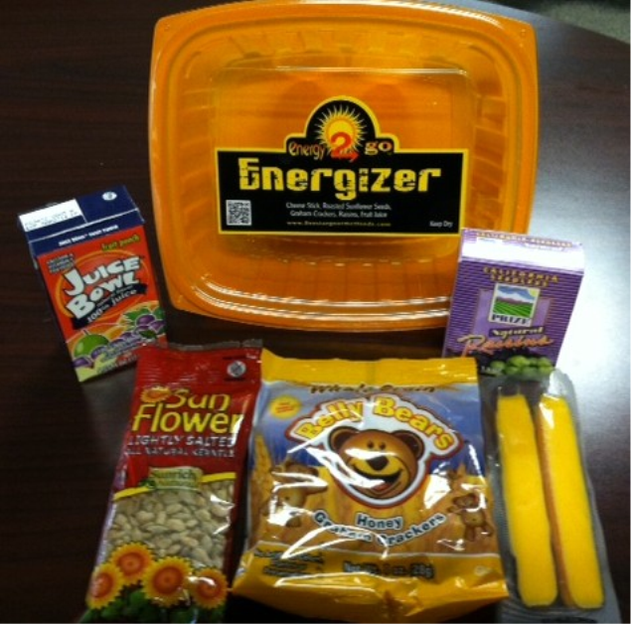
Reimbursable Supper Meal
      A reimbursable supper
      meal:
      Supper kit and milk (1%, non-fat or lactose free)
      Consumed on the
      school campus
      Prior to checking off or writing the students name all menu items must be taken
      Non-Offer Versus Serve
      Supper kit and 1% Milk
      OR
      Supper kit and non fat milk
      OR
      Supper kit and lactose free milk
Notes:
Read Slide:
A reimbursable supper meal consist of a supper kit and a milk.
Meals must be consumed on the school campus. We suggest the person distributing the meals verbally remind the children of this policy.
A numbered box is not marked off until the child has received a complete meal.
The supper meal is a not OFFER VERSUS SERVE, so essentially the child must take one of every item.

Slide 25

Point of Service Guideline
Line Starts Here
Consumed on the school campus
Notes:
TELL:
To ensure that we are in compliance with the correct point of service, the slide illustrates how to serve the meals. Prior to the children forming the line, pre-set out the supper meals kits, milk choices and the Reimbursable Meal Worksheet placed at the end of the service line. It is acceptable practice to place a milk on top of each supper kit. Once the service line is set up, have the children form a single line. Each child must take a complete meal consisting of a supper meal kit and milk. Mark off the number on the reimbursable meal worksheet and inform the child that the meals are to be eaten on the campus. Three easy steps and you are in compliance!

Slide 26
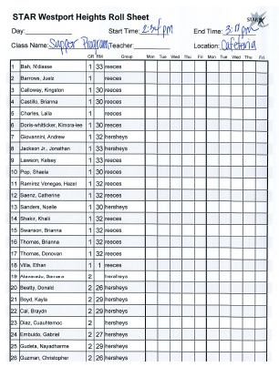
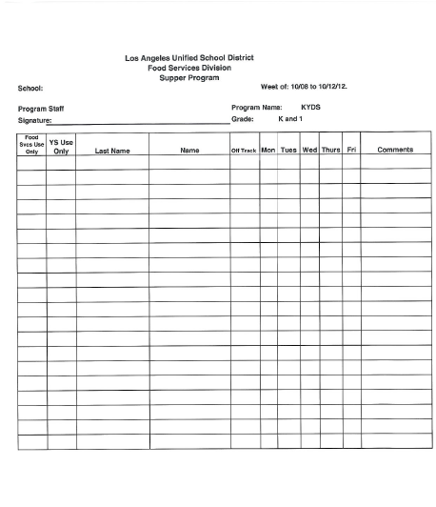
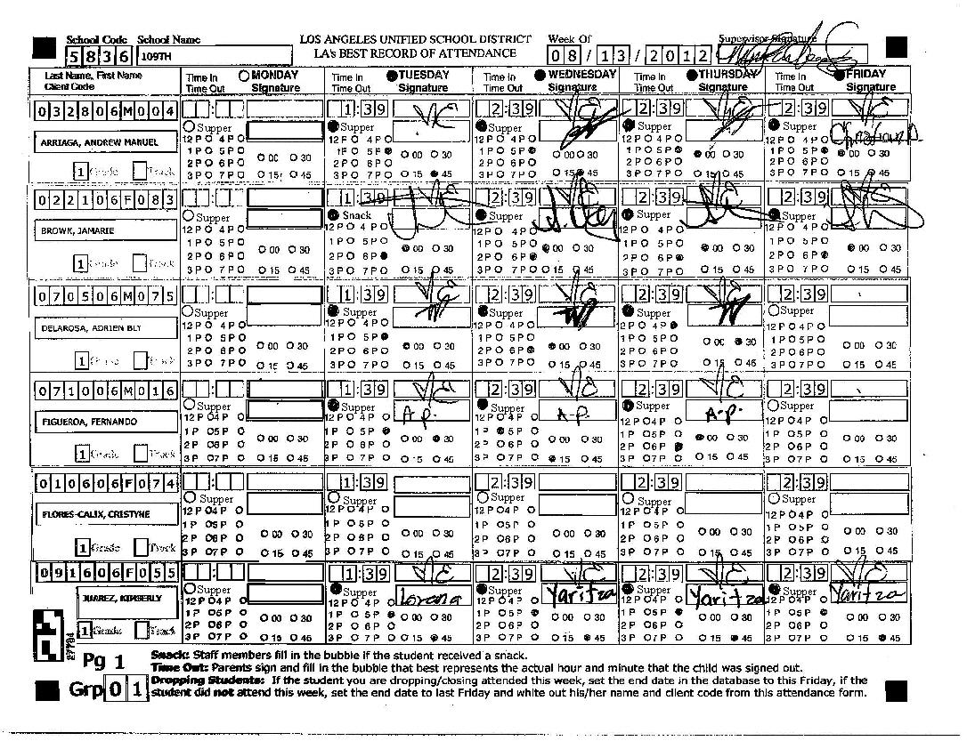
Weekly Attendance Rosters
Weekly attendance rosters are used by on site programs, these rosters are not used by Youth Services programs
The purpose of the attendance rosters is to document those who were in attendance on any given day
At the completion of Fridays meal service, return the weekly attendance roster to the FS Manager with the supper count form
Notes:
READ SLIDE:
Weekly attendance rosters are used by on site programs to track the amount of children in attendance. Attendance rosters may be used to track up to one week of attendance figures. These types of rosters are not used by Youth Services programs.
The purpose of the attendance rosters is to document those who were in attendance on any given day. At the completion of Fridays meal service, the program coordinator or designee will make a copy of the weekly attendance for the FSM and retain the original for your records. The weekly attendance roster is returned to the FS Manager, along with the Friday supper count form and reimbursable meal worksheet.

Slide 27
Youth Services /High School ONLY
Supper Community Feed Attendance Roster
    Participants (including non-after school participants) sign their names on the Supper Community Feed Attendance Roster
    Names must be legible
    Count the number of student names to determine how many students were in attendance
    The number of students in attendance is documented on the Supper Meal Count form
    Sign-up sheets should be collected and returned to the Food Services Manager daily
Notes:
TELL:
The Supper Community Feed Attendance Roster is used to track the daily attendance of students who are enrolled in an after school program. This would include community members, children attending the Youth Services program and/or children participants in after school activities; for example football, track and band practice. The names may be written by an adult or the child, regardless of you writes the names, they must be legible.
Count the number of student names written on the form to determine how many students were in attendance for the day.
The number of students in attendance is documented on the Supper Meal Count form, in the upper right hand corner.
Sign-up sheets should be collected and returned to the Food Services Manager daily.

Slide 28
At Risk After School Supper Program
Reimbursable Meal Worksheet
The reimbursable meal worksheet is used to check off the students at the POS after all menu items have been taken by the child
Mark off the numbers on the worksheet in numerical order by using check marks, slashes or X’s
The last number marked will represent the amount of children served.
The total from this worksheet is placed into column #8 (Children Served) of the Supper Meal Count Form
Notes:
TELL: The reimbursable meal worksheet on this slide is used to check off the students at the POS after all menu items have been taken by the child. Simply mark off the numbers on the worksheet in numerical order by using a check marks, slashes or X’s. The last number checked off will represent the amount of children served. The total from this worksheet is placed into column #8 (Children Served) of the Supper Meal Count Form.

Slide 29
Supper Program Reminders
Child & Adult Care Food Program (CACFP) provides reimbursements for supper served to school aged children
  Up to the age of 18 (or individuals of any age if disabled)
  Do not have to be enrolled in the after school program
  No requirement that children receiving meals participate in the offered activities
  Available afterschool, on weekends, and holidays
  Children must receive all supper menu items
Ensure suppers are consumed on campus
Return all un-served suppers to the cafeteria
  Un-Served suppers are meals not given to students
Notes:
TELL:
To recap the Child & Adult Care Food Program (CACFP) provides reimbursements for supper served to school aged children up to the age of 18 or individuals of any age if disabled. Participants do not have to be enrolled in the after school program and there is no requirement that children receiving meals participate in the offered activities. Supper meals are available afterschool, and even on the weekends and holidays if requested in advance. Children must receive all supper menu items and the program staff must ensure suppers are consumed on campus. No food items may be taken when the child leaves the campus. All un served suppers are returned to the cafeteria, un-Served suppers are meals not taken by children.

Slide 30
Review Questions
Whom do you speak to in order to make adjustments to your supper order?
  Food Services Manager
How many weeks notice does the manager need to make adjustments to their order?
  Two weeks
How often do you turn in the Supper Meal Count Form to the manager?
  Daily
Notes:
READ SLIDE AND CLICK THROUGH FOR THE ANSWERS

Slide 31
Review Questions
True or False: It is acceptable to count the number of children served a supper as they sit at the tables eating.
  False. The reimbursable meal is counted only at the point of service, as the child takes the complete supper.
True or False: Adults can also receive a supper as long as it is the complete supper.
  False. Suppers are for children only
True or False: The Supper Service Agreement form is given to the Food Services Manager?
  True. The Supper Service Agreement form is given to the Food Services Manager.
Notes:
READ THE QUESTIONS

Slide 32
Review Questions
If a child takes a milk or a juice only is this still considered a reimbursable meal?
  No. Child must take all the supper items.
True or False: Supper service begins right after school ends.
  True. However, there is no state mandated service time required.
Notes:
READ SLIDE AND CLICK THROUGH FOR THE ANSWERS

Slide 33
Key Points To Remember
A reimbursable (complete meal) must be taken by participating students
  Supper Kit and Milk (1% , Non-Fat or Lactose Free)
Immediately after the child receives a reimbursable supper meal the child needs to be marked off on the Reimbursable Meal Worksheet
Point of Service Guidelines:
  Set up your service area with supper meal kits, milk and Reimbursable Meal Worksheet
  Children take a complete reimbursable supper meal
  Marked off the meal served on the Reimbursable Meal Worksheet
  Student consumes the meal on the campus
Notes:
TELL:
A reimbursable (complete meal) must be taken by participating children, which includes a complete supper meal kit and a milk, either 1% , Non-Fat or Lactose Free. Immediately after the child receives a reimbursable supper meal, the meal needs to be marked off on the Reimbursable Meal Worksheet by checking of the next available number on the worksheet.
To remain in compliance the Point of Service Guidelines must be followed correctly.
This is done by setting up your service area with the supper meal kits, milk and the Reimbursable Meal Worksheet. Immediately after the children take a complete reimbursable supper meal, you mark off the meal served on the Reimbursable Meal Worksheet. Children consumes the meal on the campus.

Slide 34
Key Points To Remember cont…
Supper meal must be consumed in the designated eating area on the school campus
Attendance and Meal Counts must be provided daily on the “Supper Meal Count Form”
Documentation
  Prepare copies of the following documents and keep on hand at all times
    Meal Service Agreement Forms
    At Risk After School Supper Program Reimbursable Meal Worksheets
    Attendance Rosters/Supper Community Feed Attendance Rosters
    One month’s completed “Supper Meal Count Forms”
    Maintained by the program coordinator in a binder/folder
    Readily available for site monitoring and audits
Notes:
TELL:
Remember supper meals must be consumed in the designated eating area on the school campus. Attendance and Meal Counts must be provided daily on the “Supper Meal Count Form”. The program coordinator or designee prepares copies of the Meal Service Agreement Forms, At Risk After School Program Reimbursable Meal Worksheets, attendance rosters and supper community feed attendance rosters. These documents must be keep on hand at all times and maintained by the program coordinator in a binder/folder readily available for site monitoring and audits.

Slide 35
Key Points To Remember cont…
Supper meals are not served to adults
Supper meals are served to school aged children
  Up to the age of 18 (or individuals of any age if disabled)
  Do not have to be enrolled in the after school program
  No requirement that children receiving meals participate in the offered activities
  Available afterschool, on weekends, and holidays if applicable
Notes:
TELL:
Supper meals are not served to adults. Supper meals are served to school aged children, up to the age of 18 or individuals of any age if disabled. They do not have to be enrolled in the after school program. There is no requirement that children receiving meals participate in the offered activities. Suppers are available afterschool, on weekends, and holidays if applicable.

Slide 36
Contacts
ELEMENTARY SCHOOL UNIT
Serving all Elementary School Sites except YDP Sites
2060 West 156th Street, Gardena, 90249
Office (310) 515-3010 Fax (310) 527-7147
Marie Bracamonte, Field Coordinator marie.bracamonte@lausd.net
MIDDLE SCHOOL UNIT
Serving all Middle School Sites
611 Jackson Street, Los Angeles, CA 90012
Office (213) 633-3500 Fax (213) 633-3500
Carlos Martinez, Field Coordinator carlos.x.martinez@lausd.net
YOUTH DEVELOPMENT PROGRAM UNIT
Serving Youth Development Program (YDP) & Youth Services at YDP Sites
5607 Capistrano Avenue, Woodland Hills, CA 91367
Office (818) 587-4300 Fax (818) 713-8554
Isaure Blandin, Field Coordinator isaure.blandin@lausd.net
Notes:
Read Slide
Issues relating to the After School Supper Program may be communicated by contacting the Field Coordinators of the units.

Slide 37
Questions?
Thank you!
LAUSD Food Services Division
Nourishing Children to Achieve Excellence
Notes:
TELL:
This concludes the training. Thank you and we look forward to the continued success of the supper meal program.

